Slide 1

Testing AI Powered E-Learning Apps
SOCRATIC
Fall 2023 - CMPE287
Group-3

Slide 2
Contributors
Harish Marepalli (016707314)
Sowjanya Bheemineni (016672214)
Sohan Leburu (017408768)
Tirumala Saiteja Goruganthu (016707210)

Slide 3

SOCRATIC APP
Socratic is an AI app used for educational purposes.
It covers wide range of topics like Math, Science, Biology, etc.
It takes in questions from the student and provides relevant solutions.
The app takes in three forms of input- Image, Text, and Voice

Slide 4
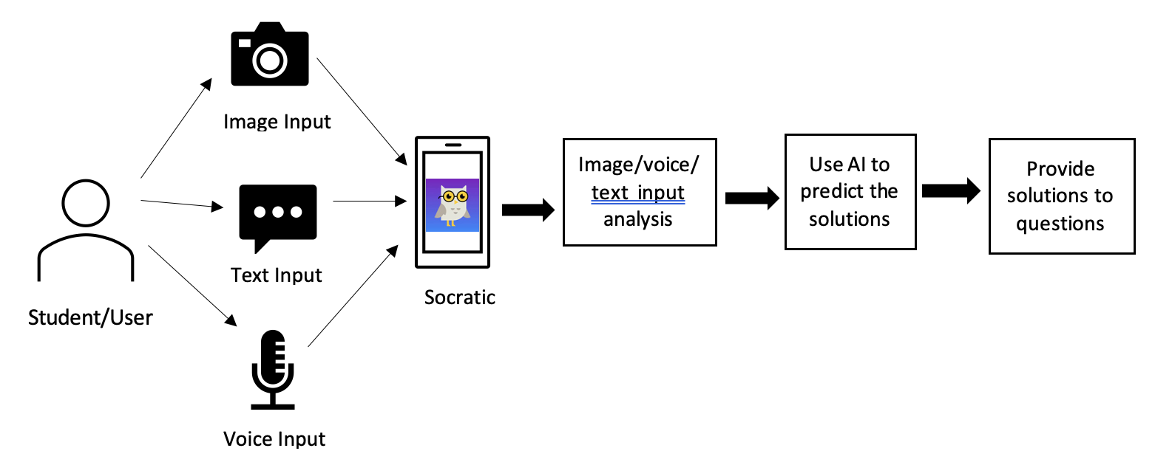
SOCRATIC ARCHITECTURE

Slide 5
Testing Subject
Mathematics (Algebra)
Linear Equations
Quadratic Equations
Polynomial Equations
Exponential Equations
Testing Text-Based Inputs

Slide 6
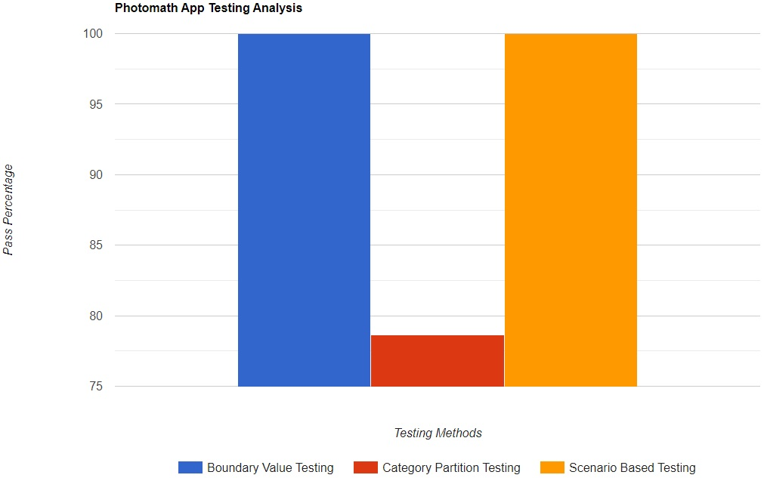
CONVENTIONAL TESTING SUMMARY
Test Method | SOCRATIC
Boundary Value Testing | 100%
Category Partition Testing | 78.62%
Scenario Testing | 100%

Slide 7
CONVENTIONAL TEST COST
Function | Cost
Discussion | 180 min
Test Methods | 120 min
Test Case | 80 min
Test Data | 40 min
Test Analysis and Summary | 30 min

Slide 8
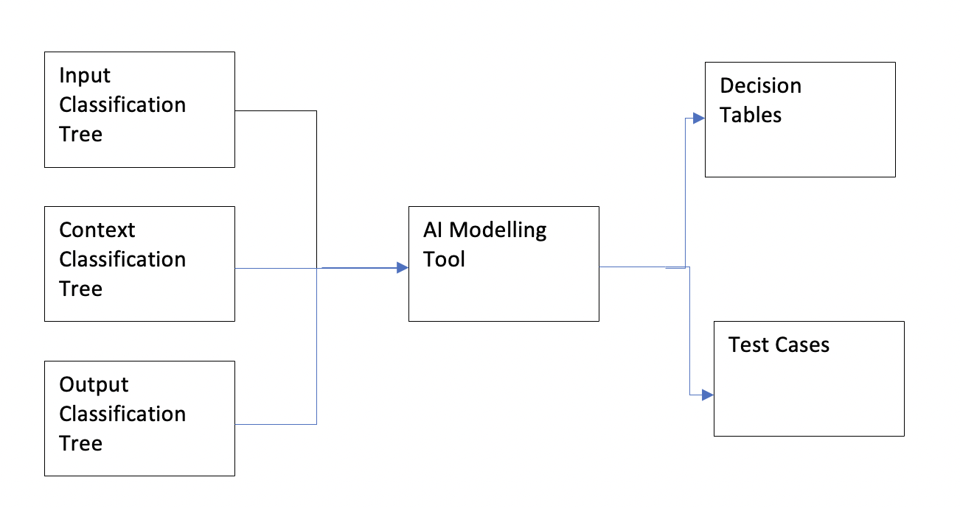
AI Test Modeling
We are utilizing an AI testing tool to build models for AI function test requirements.
We have classified our inputs based on the Math subject, with different question difficulties.

Slide 9
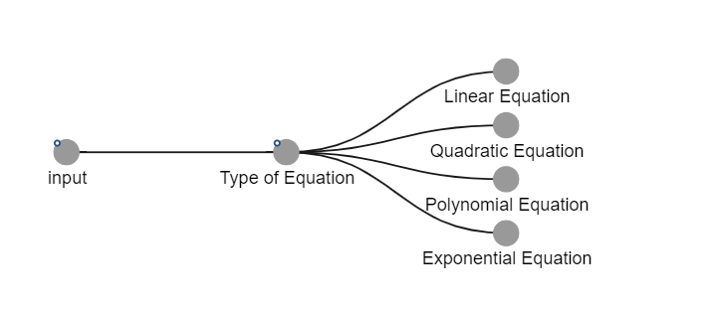
INPUT TREE Model

Slide 10
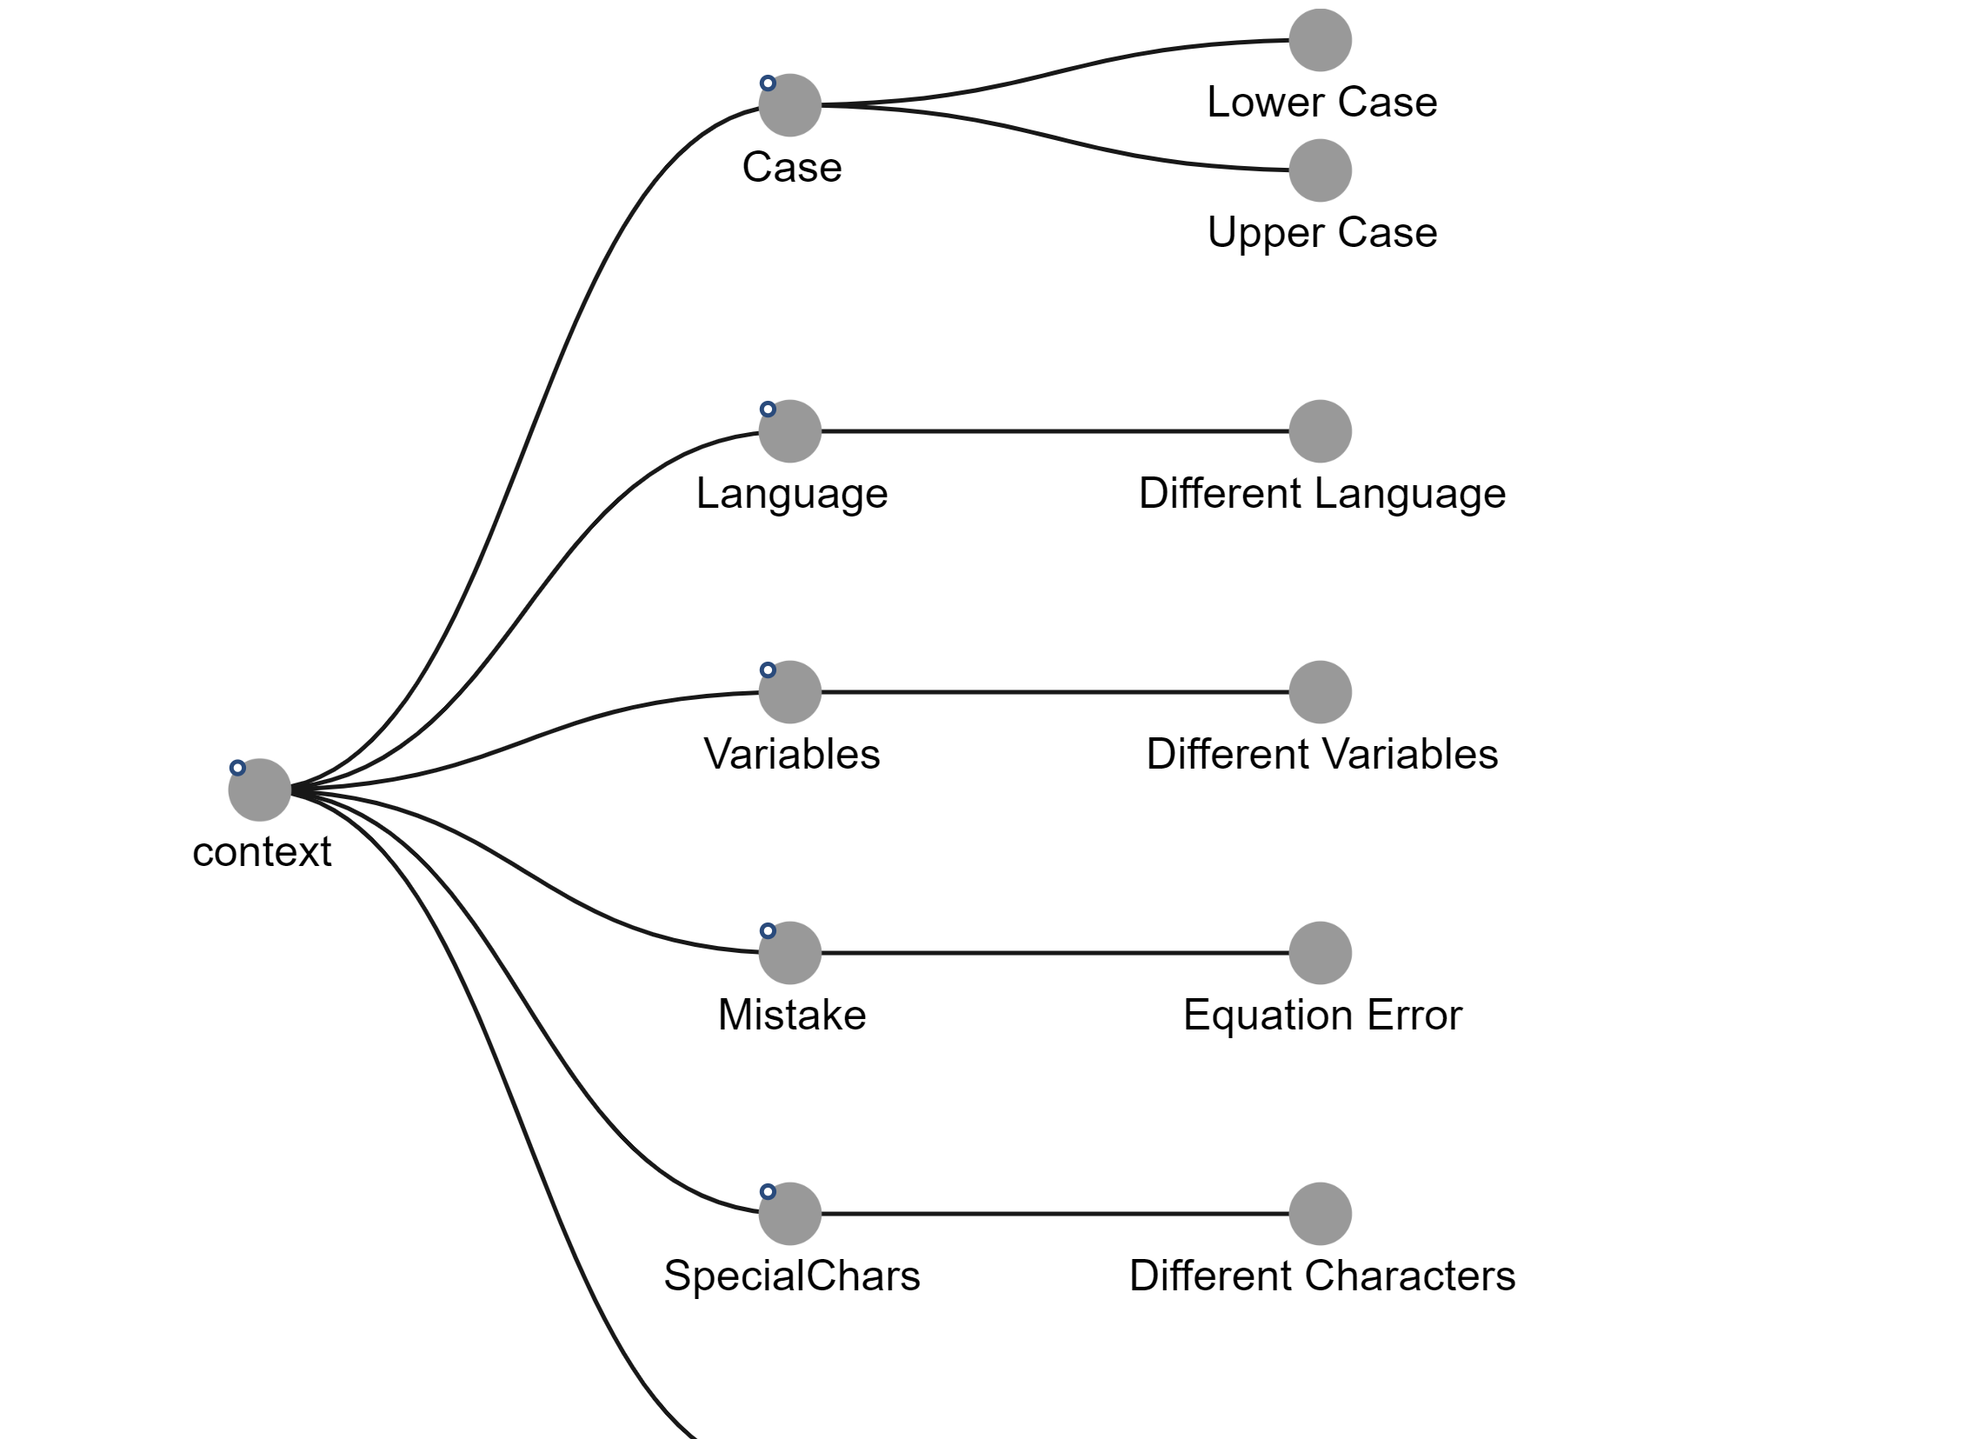
CONTEXT TREE MODEL

Slide 11
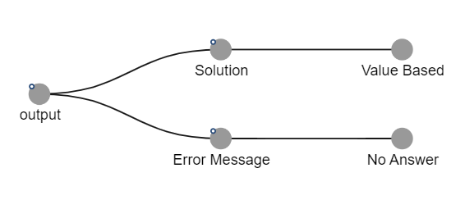
OUTPUT TREE MODEL

Slide 12
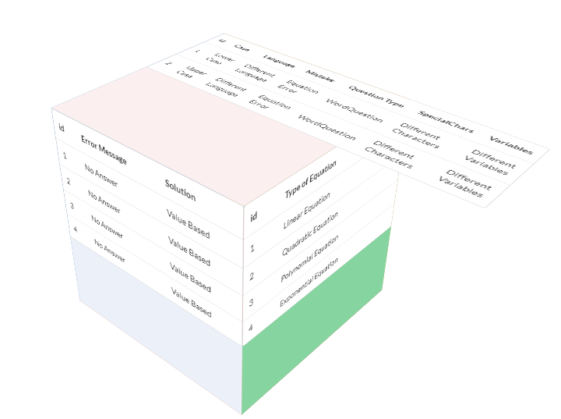
3D DECISION TABLE

Slide 13
TEST DATA
Test Case ID | 1
Test Topic | Algebra (Linear Equations)
Test Description | Linear Equation with variable on both sides
AI Context Type | Lower Case
Test Case Input | 12x + 10 = 4x + 26
Performed By | Sohan Leburu
Execution Date | 1st December 2023
AI Output Type | Value-Based
Expected Result | x = 2
Actual Result | x=2
Test Case Result | Pass
Test Case ID | 10
Test Topic | Algebra (Exponential Equations)
Test Description | Exponentials in Telugu
AI Context Type | Different Language
Test Case Input | x = 1 మరియు y = 15 సంఖ్యల కోసం y=a(b^x) రూపంలో ఘాతాంక సమీకరణాన్ని వ్రాయండి
Performed By | Saiteja Goruganthu
Execution Date | 1st December 2023
AI Output Type | Value-Based
Expected Result | 15=ab
Actual Result | No Answer
Test Case Result | Fail

Slide 14
TEST DATA
Test Case ID | 19
Test Topic | Algebra (Polynomial Equations)
Test Description | Polynomial Equation with extra plus symbols
AI Context Type | Mistake in the Equation
Test Case Input | x^2 ++ 2x - one = 0
Performed By | Harish Marepalli
Execution Date | 1st December 2023
AI Output Type | Value-Based
Expected Result | No Answer
Actual Result | No Answer
Test Case Result | Pass
Test Case ID | 25
Test Topic | Algebra (Quadratic Equations)
Test Description | Different Variables
AI Context Type | Lower Case
Test Case Input | 1000α^2 - 2000α + 1000 = 0
Performed By | Sowjanya Bheemineni
Execution Date | 1st December 2023
AI Output Type | Value-Based
Expected Result | α=1
Actual Result | No Answer
Test Case Result | Fail

Slide 15
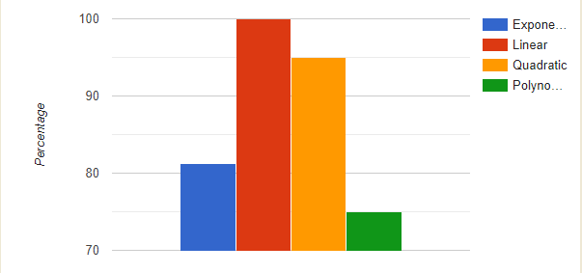
TEST REPORT
Input Test Case Results
 | Socratic
Exponential | 13/16 = 81.25%
Linear | 20/20 = 100%
Quadratic | 19/20 = 95%
Polynomial | 12/16 = 75%

Slide 16

BUG ANALYSIS
Took several context features into consideration such as character casing, language variation, typos, etc.
The application fails to detect the problem when input is given in any language other than English.
Application also failed to interpret most of the exponential based algebraic equations.
Socratic needs a lot of work in solving word-based equations.

Slide 17
BUG SAMPLE TEST CASEs
Test Case ID | 5
Test Topic | Algebra (Linear Equations)
Test Description | Mistake in the equation
Test Case Input | 4x + ++8y + z = 2; x + 7y - --3z = -14; 2x –-- 3y + ++2z = 3
Performed By | Sohan Leburu
Execution Date | 1st December 2023
Expected Result | -
Actual Result | -
Test Case Result | Pass
Test Case ID | 28
Test Topic | Algebra (Quadratic Equations)
Test Description | Word Problem
Test Case Input | Find the roots of x^2+5x+6=0
Performed By | Sowjanya Bheemineni
Execution Date | 1st December 2023
Expected Result | x=2, x=3
Actual Result | -
Test Case Result | Fail

Slide 18
BUG SAMPLE TEST CASEs
Test Case ID | 11
Test Topic | Algebra (Exponential Equations)
Test Description | Different Variables
Test Case Input | (-1/2)^(α-1) = -8
Performed By | Saiteja Goruganthu
Execution Date | 1st December 2023
Expected Result | α=-2
Actual Result | -
Test Case Result | Fail
Test Case ID | 20
Test Topic | Algebra (Polynomial Equations)
Test Description | Special Chars as Variables
Test Case Input | &^2 - 3& + 2 = 0
Performed By | Harish Marepalli
Execution Date | 1st December 2023
Expected Result | -
Actual Result | -
Test Case Result | Pass

Slide 19

TEST COMPLEXITY AND COVERAGE
4 input classifications.
8 context classifications
5 output classifications.
Overall Text Complexity = W*L*H
= 4*8*5
= 160

Slide 20




TEST AUTOMATION
To test the functioning of our selected application, Socratic locally, we used the following tools.
Appium is an open-source framework that allows engineers to automate testing.
Android Studio is used to run the android emulator.
Eclipse IDE is used to create a maven project and write our scripts.

Slide 21
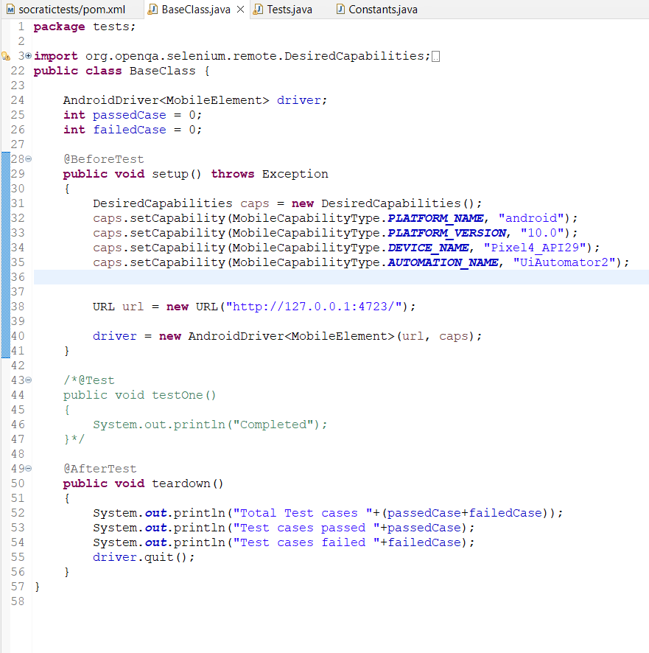
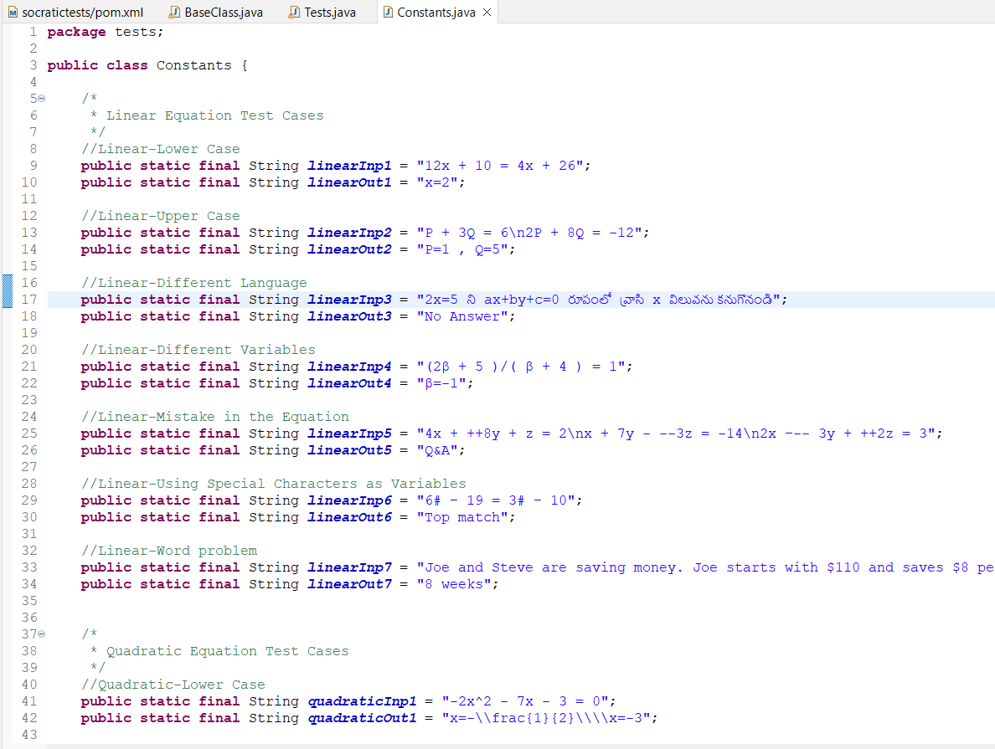
TEST SCRIPTS

Slide 22
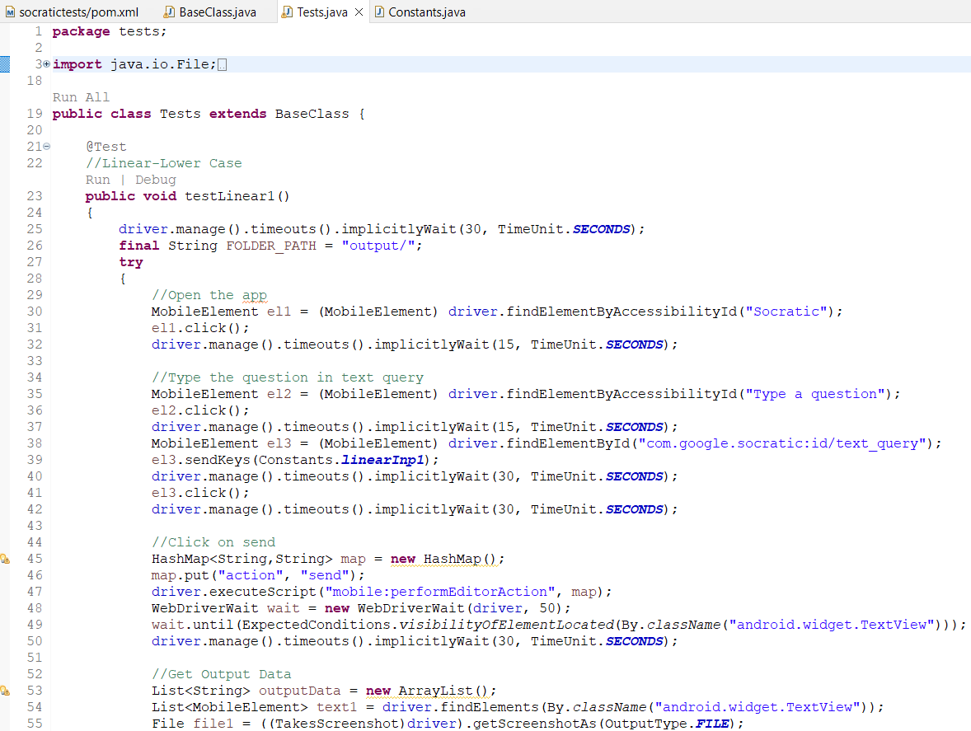
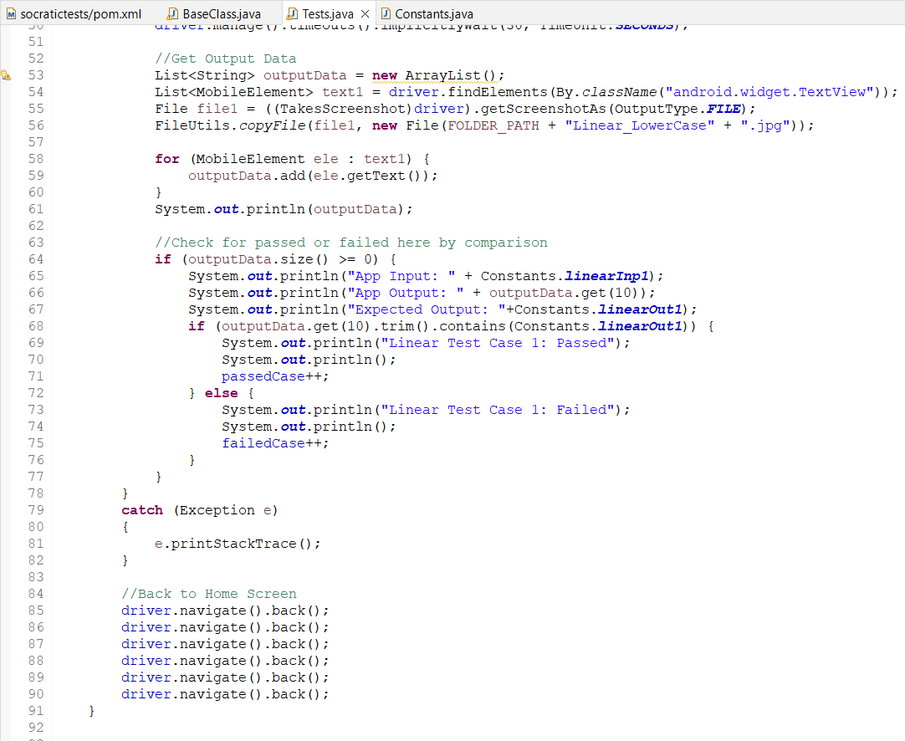
TEST SCRIPTS

Slide 23
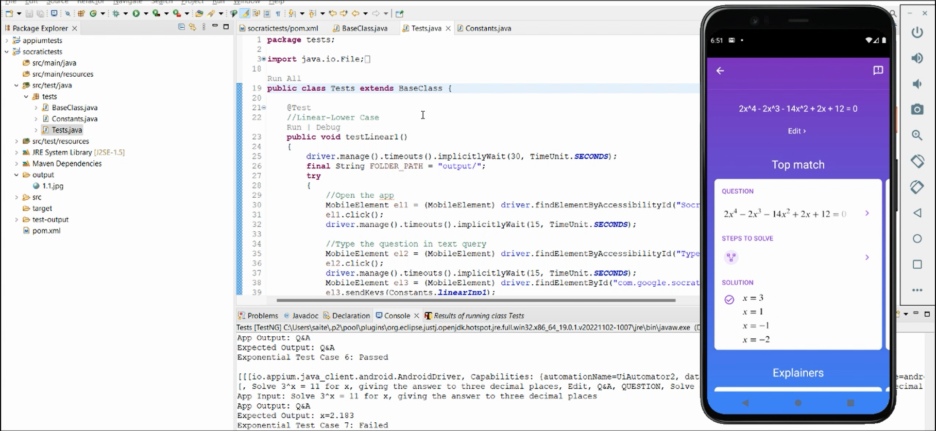
SCRIPT EXECUTION

Slide 24
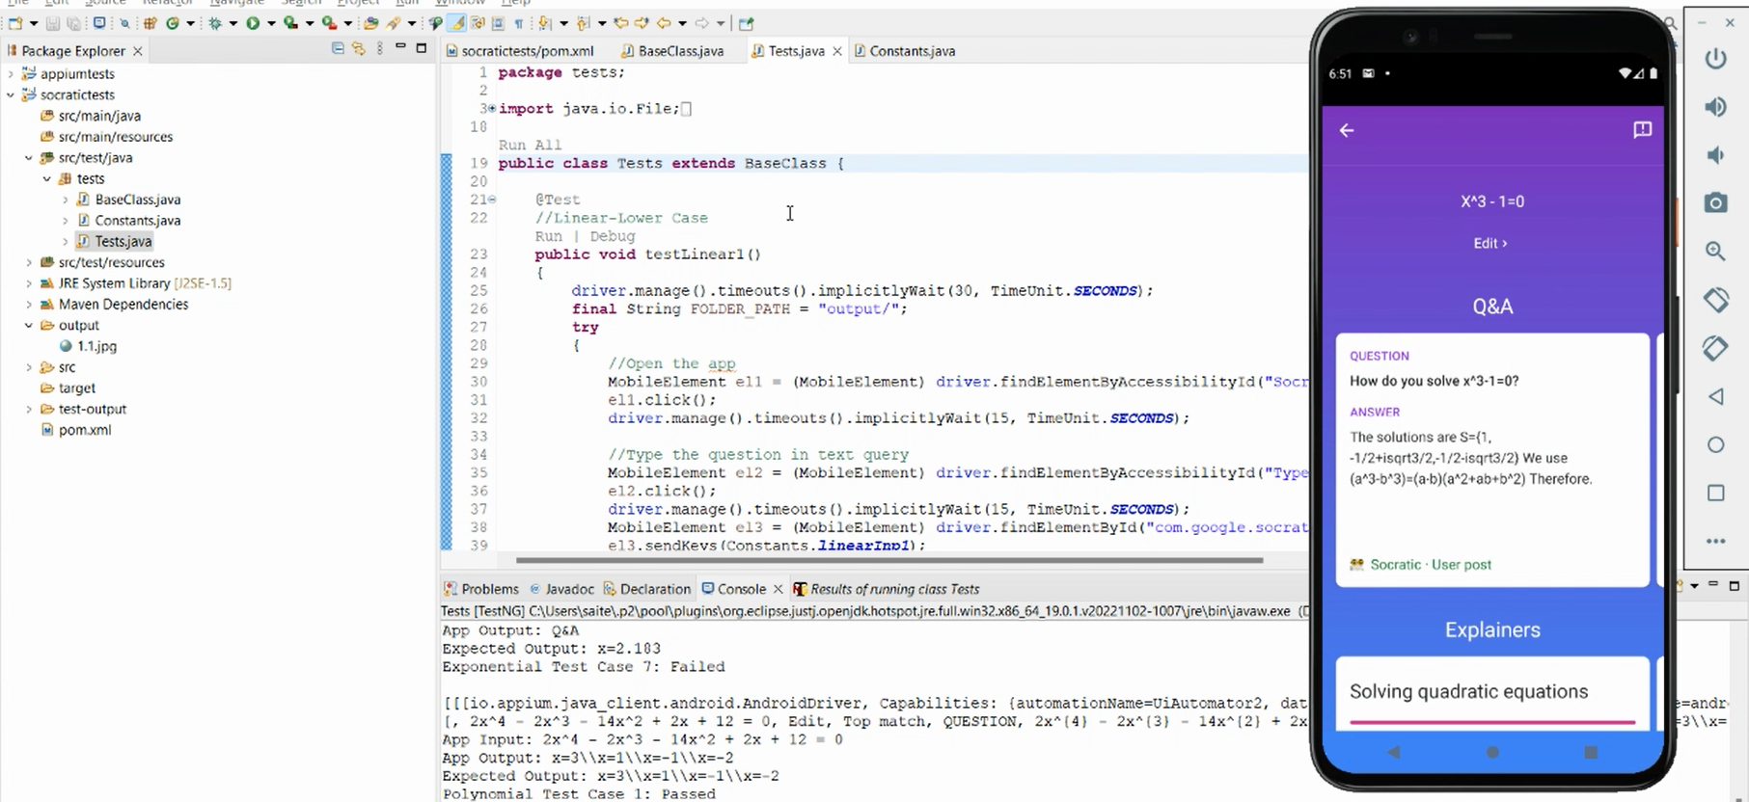
SCRIPT EXECUTION

Slide 25
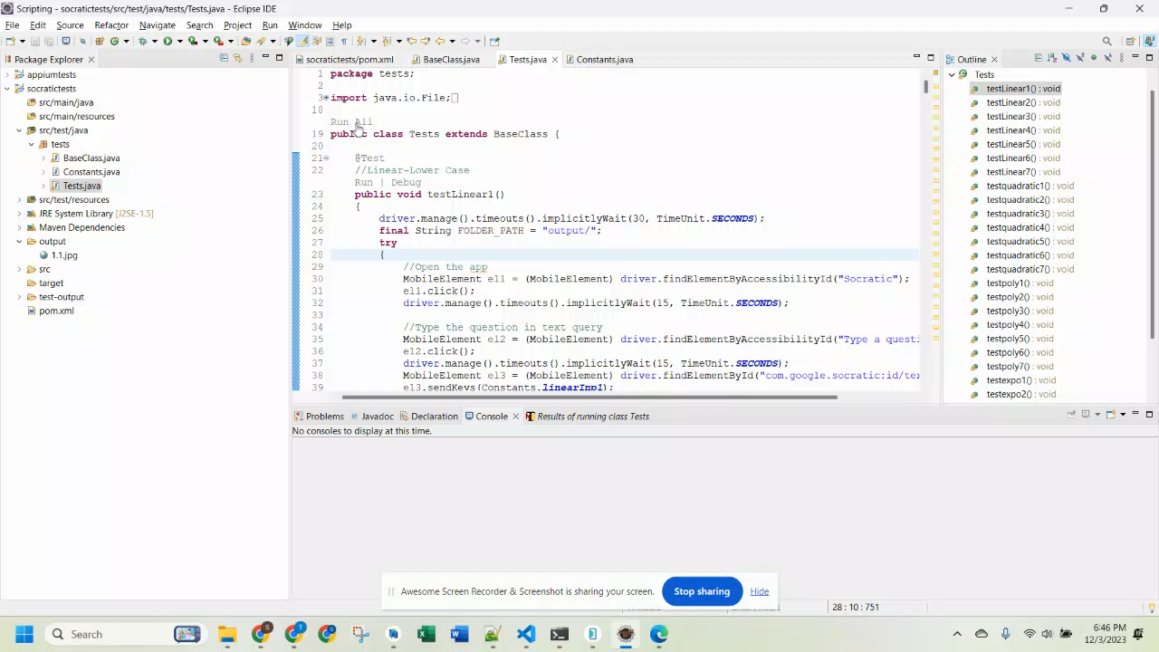
SCRIPT EXECUTION DEMO

Slide 26
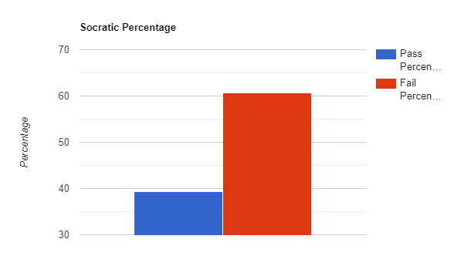
AUTOMATION REPORT
Total Test Cases | 28
No. of Passed Test Cases | 11
No. of Failed Test Cases | 17
Pass Percentage | 39.28%

Slide 27
MANUAL VS Automation
 | Manual Testing | Automation Testing
Test Cases | 80 | 28
Test Case Design / Script | 120 minutes | 360 minutes
Test Data and Execution | 200 minutes | 10 minutes
Test Environment | 250 minutes | 360 minutes

Slide 28

Thank you

